Slide 1
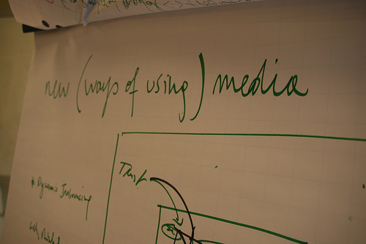

Slide 2
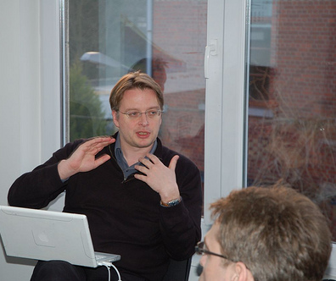
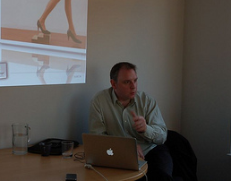
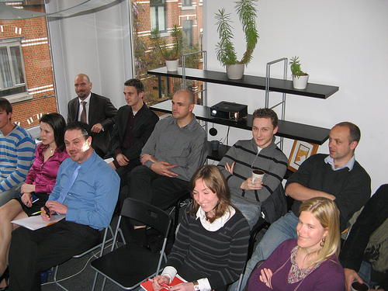
Community animation
Twitter opportunities
Case Study mobile app
Monitoring Social media
Geo-localization
Innovative mash-ups
Scrum : tips & tricks
Career mgt 2.0
Basecamp
Webwriting
DYNAMIC INSOURCING
FRIDAY SESSIONS
Friday Sessions are organized internally within Cleverwood, where a few external people are also invited.
Their goal is to share the knowledge on a particular hot topic between Cleverwood staff members.

Slide 3

Community animation
Twitter opportunities
Case Study mobile app
Monitoring Social media
Geo-localization
Innovative mash-ups
Scrum : tips & tricks
Career mgt 2.0
Basecamp
Webwriting
DYNAMIC INSOURCING
FRIDAY SESSIONS
Today’s session
Marina Aubert
Presenting
“
Web copywriting: between content creation and usability
”

Slide 4
Copywriting?

Slide 5


Slide 6
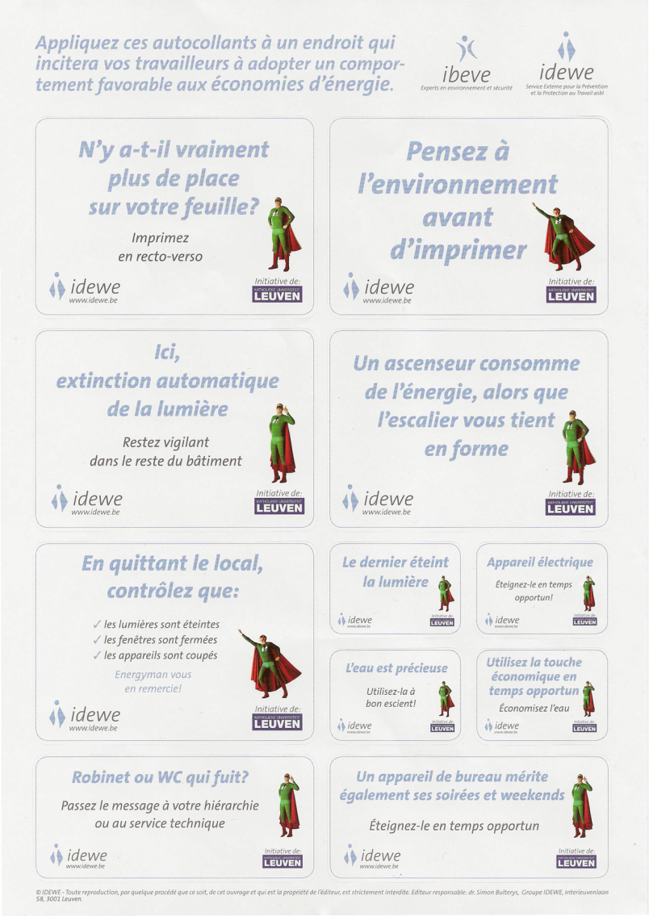

Slide 7
Web copywriting?

Slide 8
1. Web content
Create customized content

Slide 9
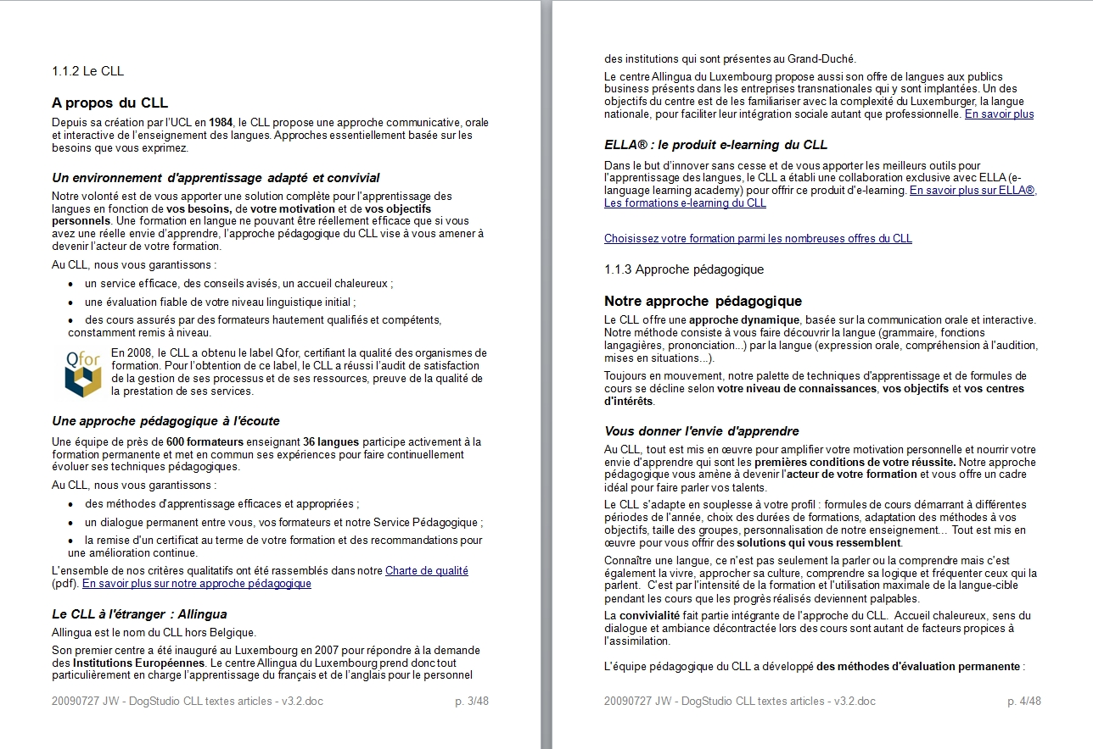
Corporate Content

Slide 10
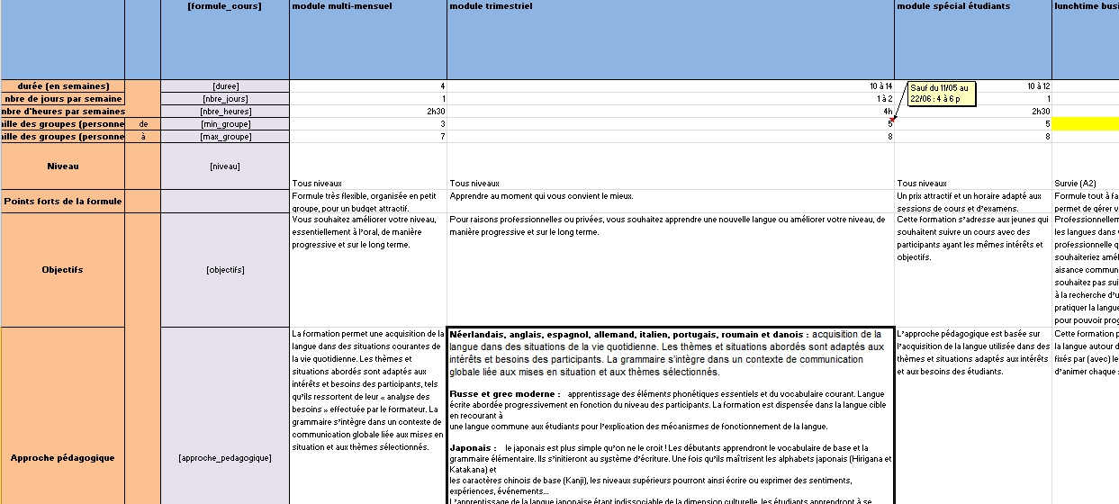
Database Content

Slide 11
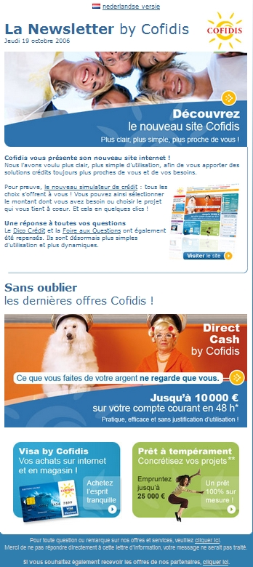
Emailing & Newsletters

Slide 12
2. Web content management
Provide proper information

Slide 13
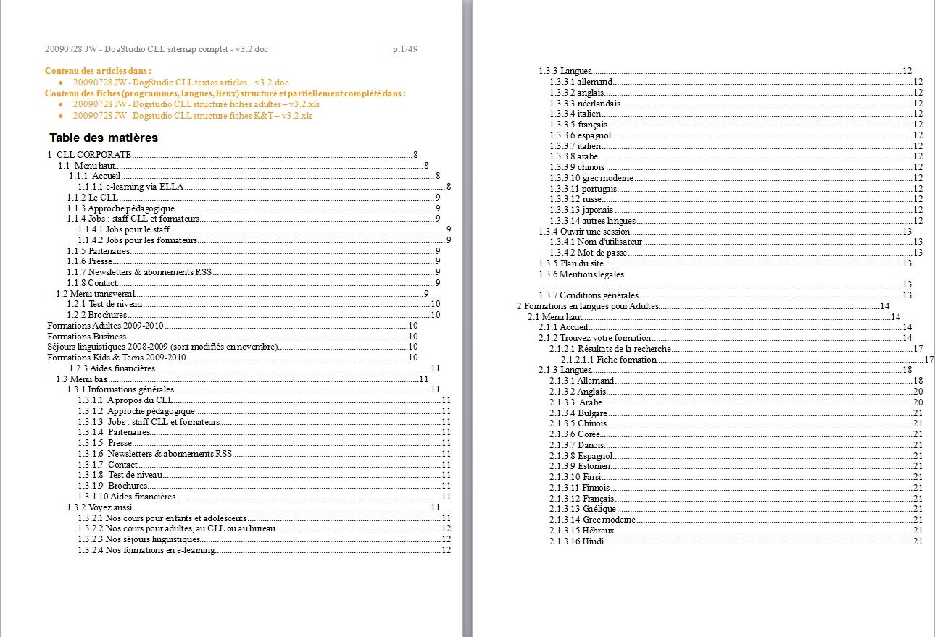
Information Architecture

Slide 14
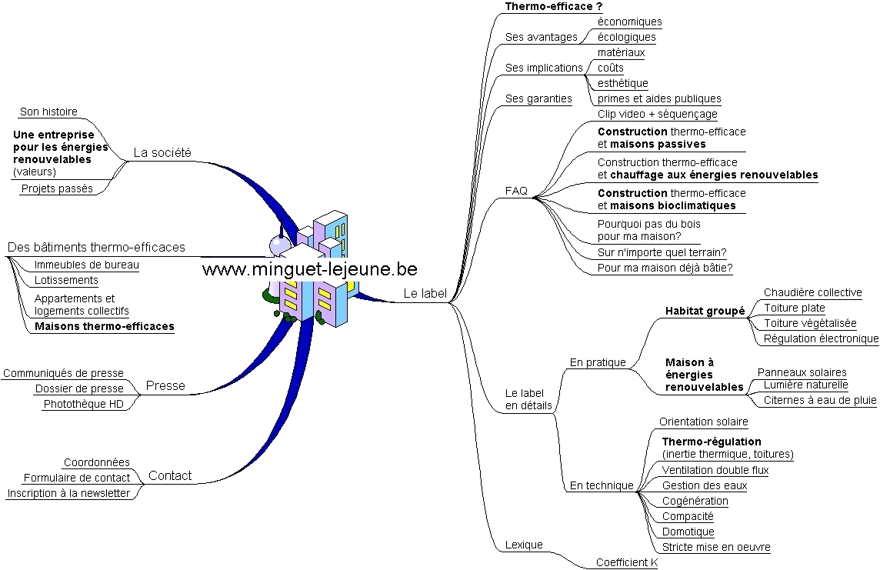
Mindmap & SEO keywords

Slide 15
SEO keywords monitoring

Slide 16
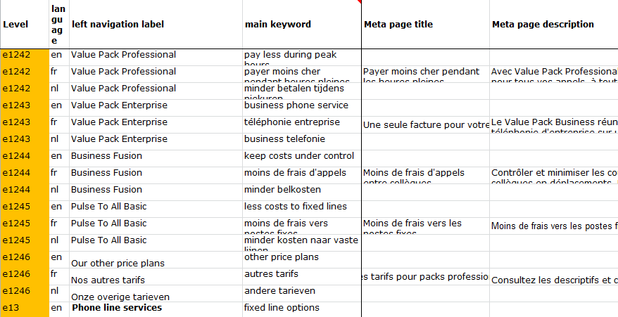
Content Strategy

Slide 17
3. Web content optimization
Create conversion funnels… or Usability?

Slide 18
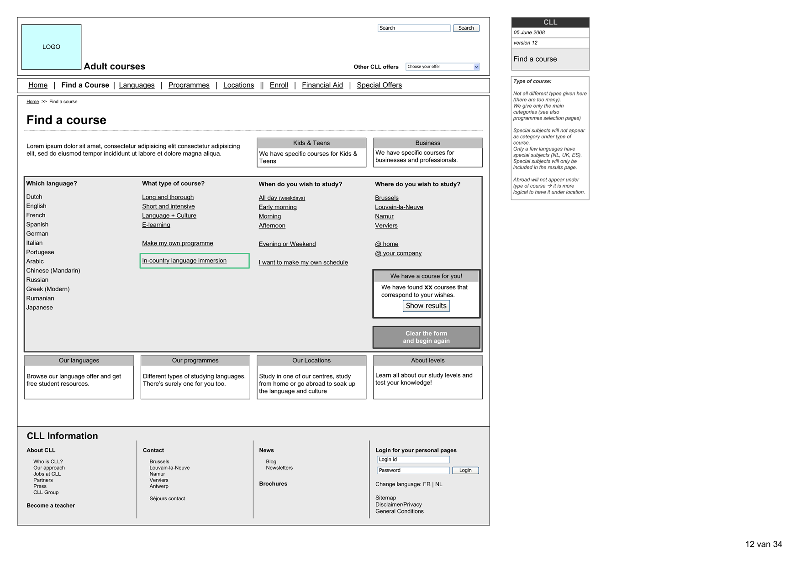
Wireframe optimization

Slide 19
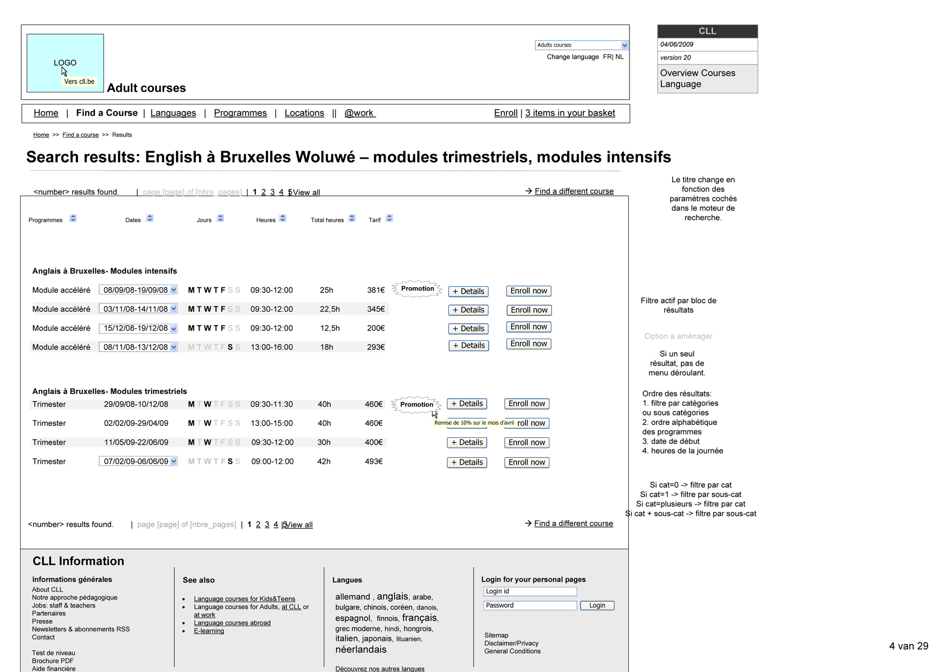

Slide 20
Not web copywriting?

Slide 21
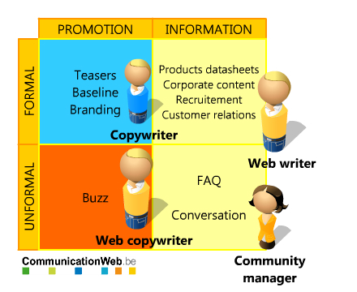
Formal & Informal Online Communication

Slide 22
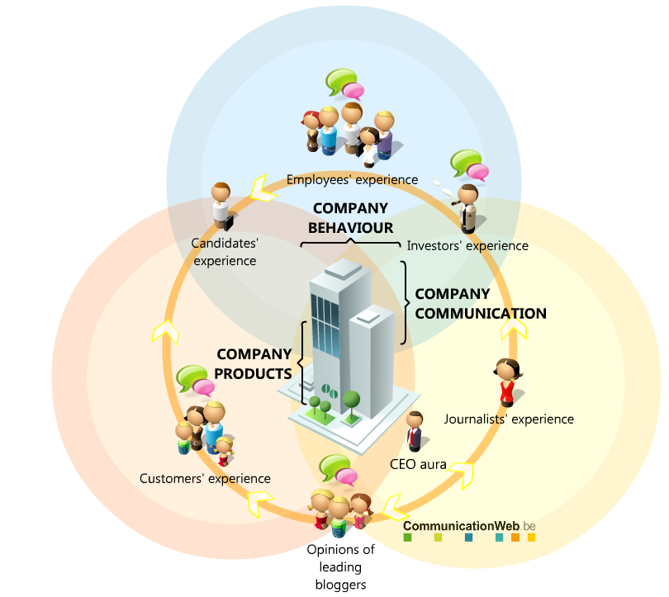
Information Visualization

Slide 23
Case study: danone

Slide 24
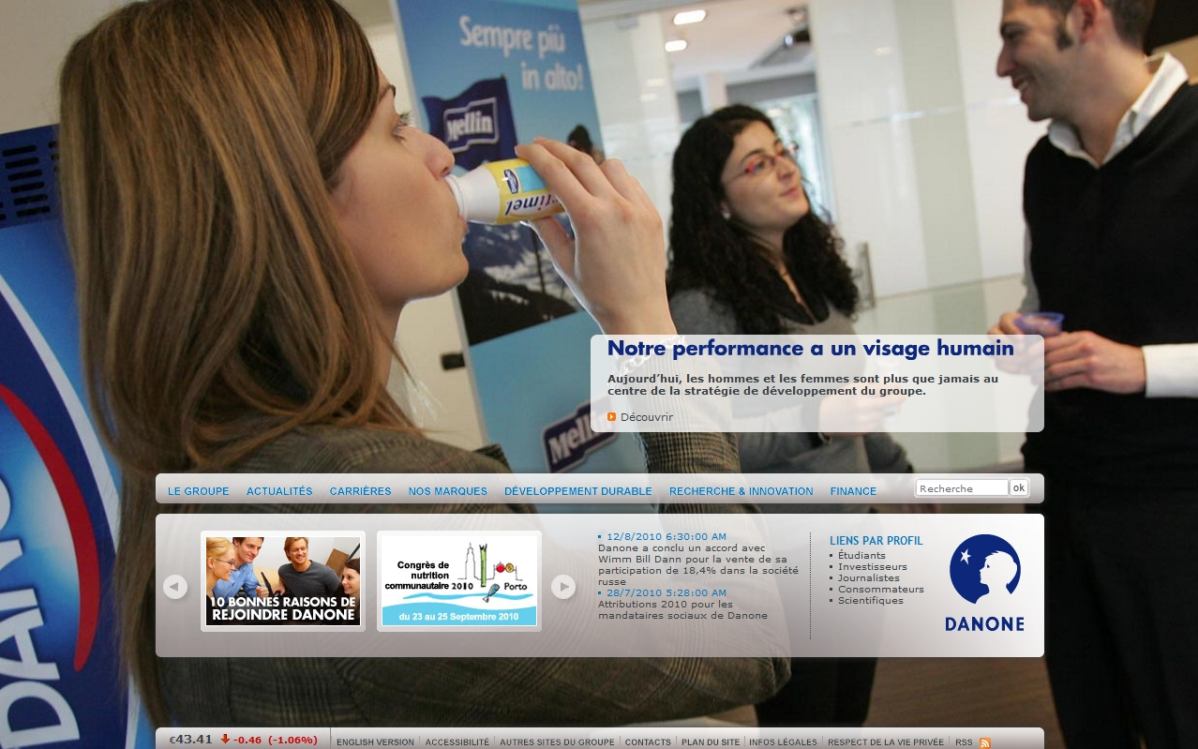
Organization’s Communication

Slide 25
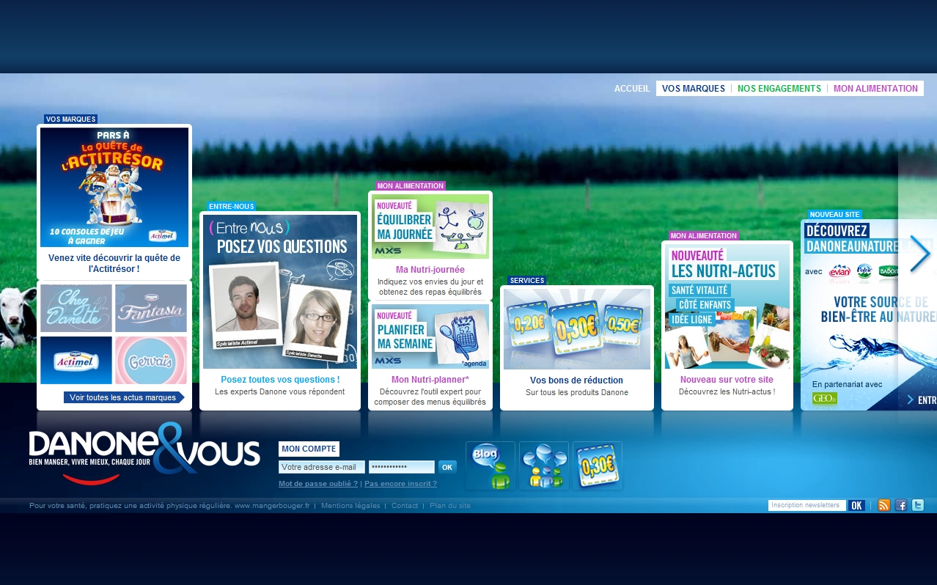
Organization’s Products

Slide 26
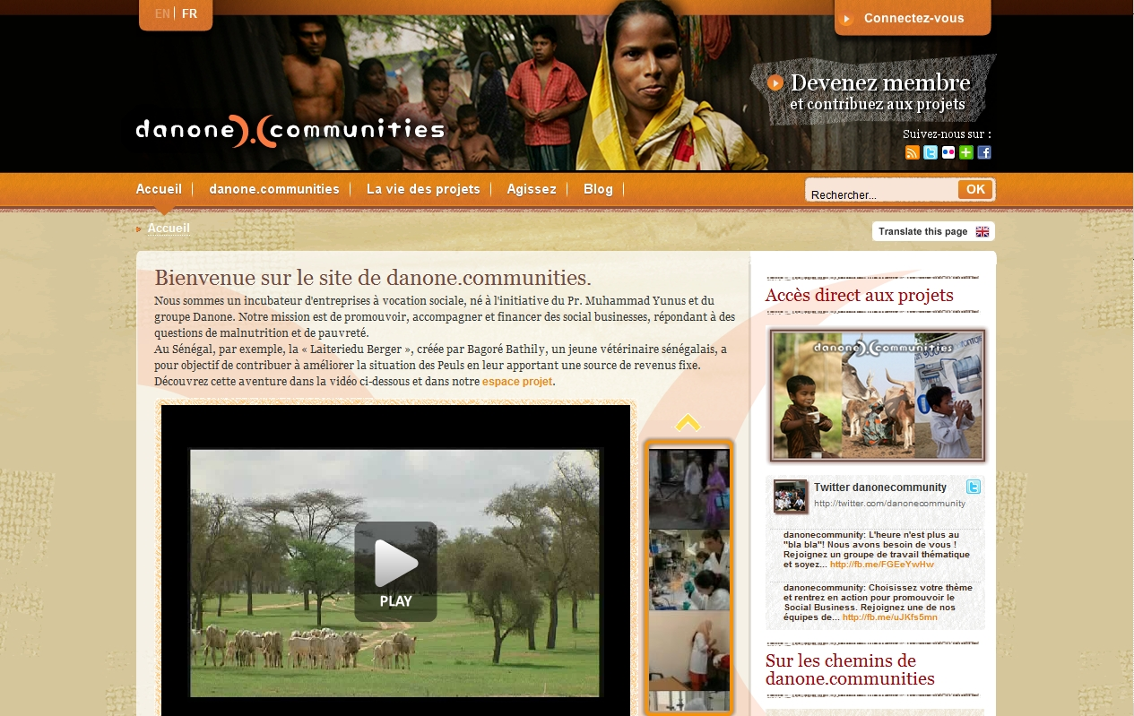
Organization’s Behaviour … undercover marketing

Slide 27

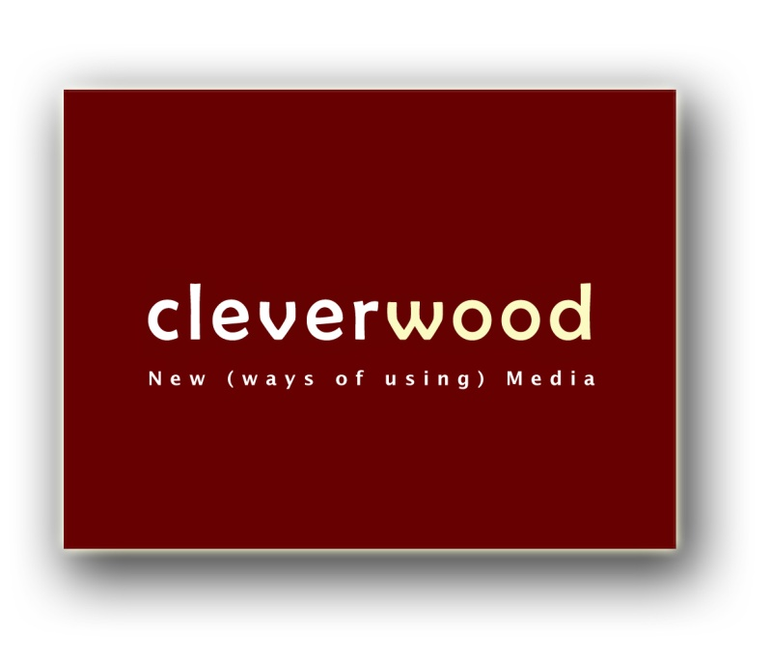
Be the next one to
organize a FAS!
+32 (0) 2 888 79 34
Cleverwood is your New Media Consulting partner, providing expertise, knowledge and consulting services for Web, Mobile, Interactive Television and emerging channels.
And tweets down here
Summary over here
Pic’s will be here
Slides will up be there
Cleverwood is a trademark of Fair Wood Ventures sprl/bvba

